Slide 1
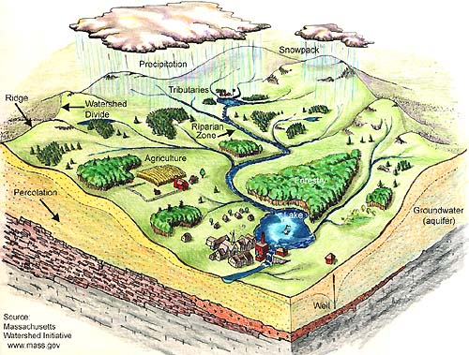

Successful Watershed Planning
Forrest Bell, FB Environmental Associates
Notes:
Welcome everyone and thank you for coming! There are a number of volunteers that have put a lot of effort into the watershed survey and we are here today to showcase the findings of the work and hopefully to encourage many of you to take small actions this year on your own properties to protect Minnehonk Lake.
How many people live in the Minnehonk Lake Watershed? How many don’t know if they do?

Slide 2

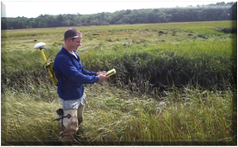
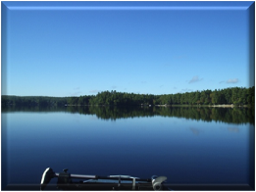
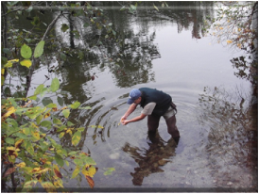
FB Environmental Associates
Offices in Portsmouth, NH and Portland, ME
Small business founded in 2001 to provide lake assessment, protection, and restoration assistance
Work with public sector clients located throughout New England
Work “where science meets civics”

Slide 3
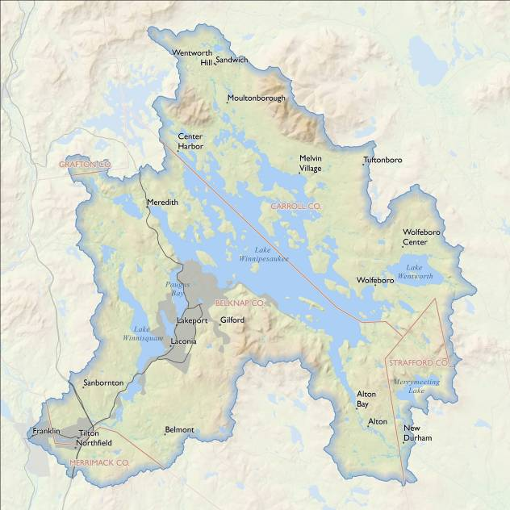
Lake Winnipesaukee Watershed Projects

Slide 4
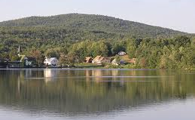
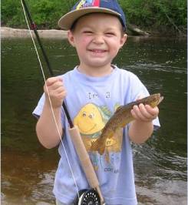
Why Develop a Plan?
Because we care about the health of our lakes and want to keep them clean for future generations to enjoy.
If a lake doesn’t meet State standards it is required.
Notes:
Lakes are polluted, in great part, by nonpoint source (NPS) pollution in the form of eroded soil and the nutrients (phosphorus) it carries. As storm water flows over bare or loose soil, these pollutants adhere to water molecules and are deposited in water bodies such as lakes, streams and oceans.
A watershed survey is designed to locate sites where soil erosion is taking place, thus threatening the quality of water in the watershed.
The CPC, GMLA and 30-Mile RWA is joining forces with the FB Environmental Associates and Maine DEP to undertake a more long-term and focused effort to protect Minnehonk Lake’s water quality.

Slide 5
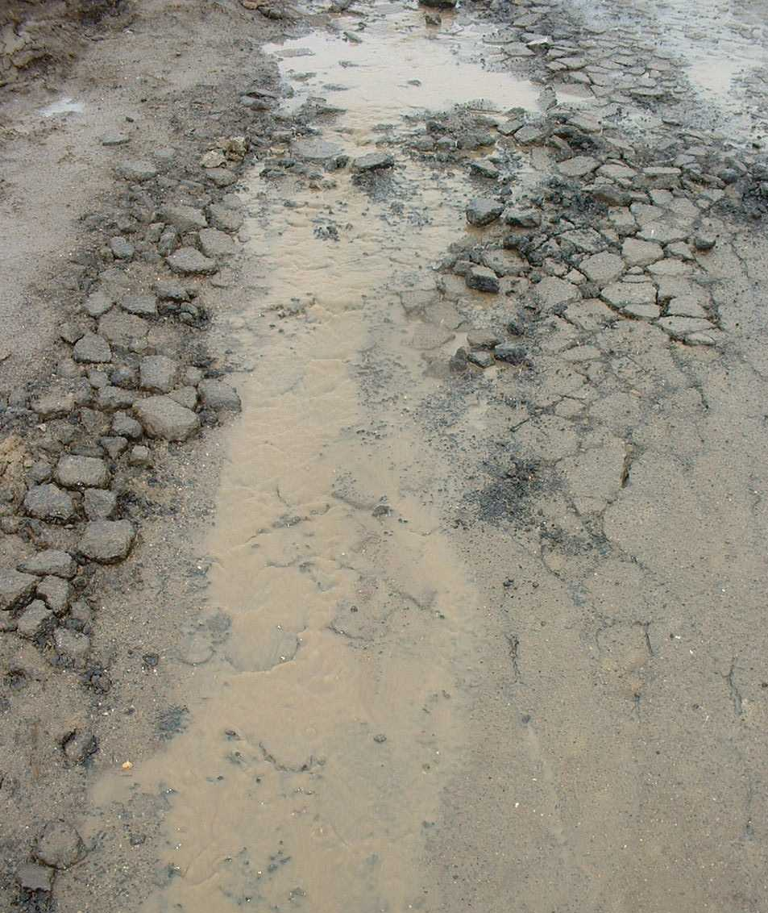
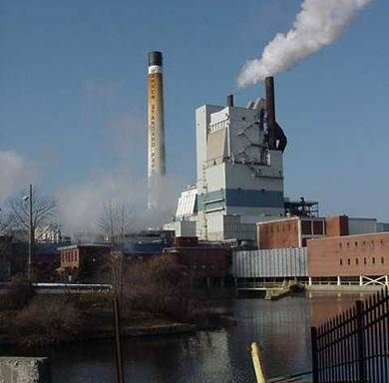
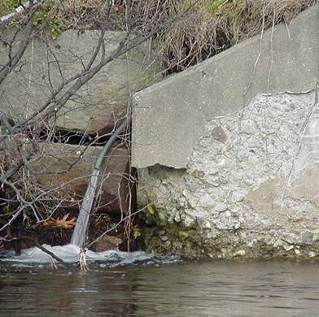
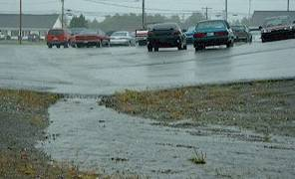
Pollution Sources
Past
Point source pollution discharged from pipe
Present
Now polluted runoff or nonpoint source pollution (NPS) from many smaller, diffuse sources
Notes:
In the past, point source pollution (pipes from factories or sewage treatment plants) were biggest problems. However, we are approaching the 30th anniversary of the Federal Clean Water Act. This law has been very successful at cleaning up these point sources.
Now, polluted runoff from many smaller sources across the landscape is causing a slow decline in our lakes. Pollutants carried in runoff include soil, nutrients, pesticides, toxics etc.

Slide 6
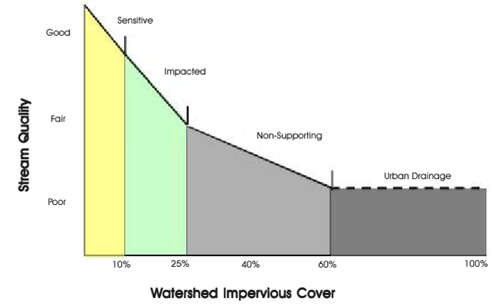
The Problem with Imperviousness
Stressed
Impacted
Non-Supporting

Slide 7
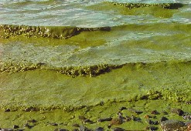
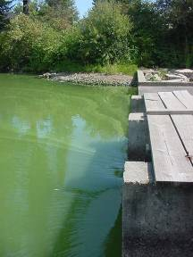
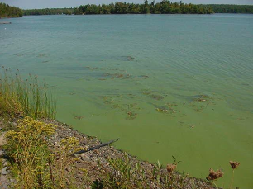
Phosphorus
Phosphorus is one of the major nutrients needed for plant growth.
Naturally present in small amounts.
Generally, as phosphorus increases, the amount of algae also increases.
Too Much P= Algae Blooms, Low DO, Fish Kills!

Slide 8
Water Quality & Property Values
For every 3 ft. decline in water clarity, shorefront property values can decline as much as 20%.
Declining property values affect individual landowners and economics of entire communities.
With property rights comes property responsibility

Slide 9
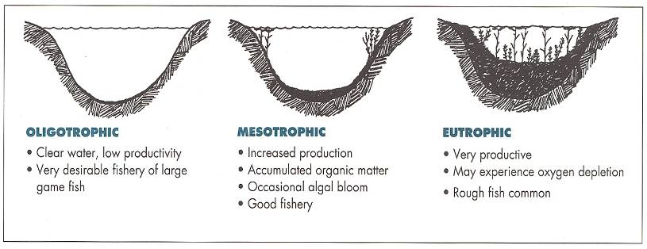
Speeding aging of lakes
10,000’s YEARS IN NATURAL CONDITIONS
10’s to 100’s YEARS UNDER HUMAN INFLUENCE
Notes:
Lakes age naturally as they become more enriched with nutrients over time. Over eons, deep crystal clear lakes become marshes and bogs. Without the visitation of another glacier, Minnesota will some day become the “Land of 10,000 bogs”.
However, by increasing the rate of nutrient enrichment by human activities, a process that would take 10,000 years can occur in a lifetime. Land distributing activities; cutting timber, farming, construction, have increased the rate of nutrient enrichment of lakes, and increased their rate of aging.
Lakes are classified according to their “tropic state”. “Tropic” means nutrition or growth. An “oligotrophic” lake has low nutrient concentrations and low plant growth. An “eutrophic” lake is high in nutrient concentration and plant growth. “Mesotrophic” lakes are between these two status.
The process of lake becoming enriched with nutrients and progressing towards the eutrophic state is call “eutrophication”.

Slide 10
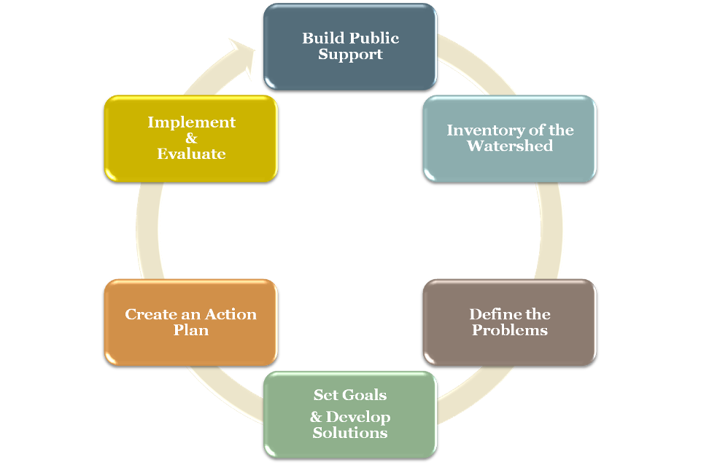
Watershed
Management
Cycle
WATERSHED MANAGEMENT PLANNING
Notes:
A series of cooperative, iterative steps
Part of a long-term effort involving towns, agencies, organizations, and individuals
Public participation: forums, meetings, stakeholder input
This plan was developed using a watershed-approach.
A holistic approach in which local stakeholders are actively involved in selecting watershed management strategies.
The watershed planning process uses a series of cooperative, iterative steps to characterize existing conditions, identify and prioritize problems, define management objectives, and develop and implement protection or remediation strategies as necessary.
Typically on a 10-15 year schedule.

Slide 11
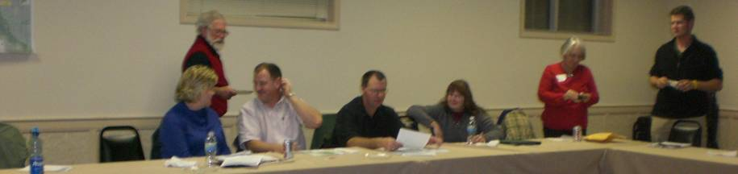
Build Strong Local Support
Form an Action Steering Committee
Landowners NH DES
Conservation Districts Town Manager/Planner
USDA/NRCS Town Planners
Lake Associations Regional Planning Assoc.
Notes:
Now that the modeling was complete, the key remaining components of the watershed-based management plan will be developed.
Our Outreach efforts returned 16 attendees ranging from landowners, to resource professionals.
These folks will be responsible for helping craft the action plan and guide the long-term process.

Slide 12
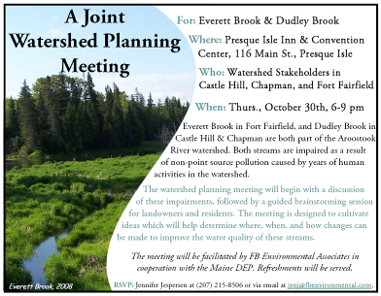
Publicize the Effort
Develop a Landowner List
Send Postcards
Personal Letters w/map
Watershed Forum
Social Media
Press Releases
Posters & Website
Phone Calls
Notes:
Strong Local Support involves utilizing different means of communication.
Emphasize the personal phone contact for completion of the TMDL and notice and collect information about interest in attending the WBMP meeting. Set a date and call them again. Send a postcard. Did you receive the postcard and are you coming? Personal Letters went out to landowners who said they weren’t interested and copies of the TMDL to people that were very interested.
Contacted the Watershed Towns-in this case, three major watershed towns shared a town manager. We provided a watershed map to the town and they provided a list of lots with names and addresses for each landowner in the watershed. We also received a list of the town selectmen and planning board members.
FB Environmental staff presented information about the TMDL at a joint TMDL and watershed planning meeting in Presque Isle on October 30, 2008. The Town of Chapman/Castle Hill/Mapleton provided FB Environmental with a list of watershed landowners. Each landowner was contacted by phone and/or mail regarding the TMDL meeting. The report was posted on the FB Environmental Internet Web site and two notices were placed in the Star Herald on October 8th and October 29th, 2008.
Note about Everett Brook-joint meeting, neighboring watershed-both impaired. Did not get a landowner list from the town, but did receive a list of major agricultural landowners, and potentially interested individuals including local recreational clubs (Boy Scouts, Fish & Game Club).

Slide 13
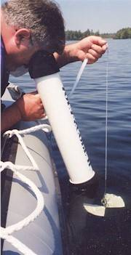
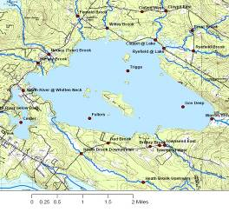
Assess Water Quality
Collect, Organize & Interpret Data
Identify Trends
Compare to Standards
Determine Assimilative Capacity
Set Water Quality Goal
Notes:
5 key parameters (Clarity, Chl_a, TP, Color, DO/Temp)

Slide 14
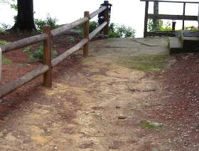
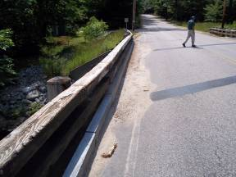
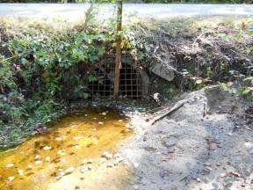
Inventory the Watershed
What is contributing to the problem?
Roads /Road Crossings
Residential Properties
Commercial Properties
Municipal Land
Forestry Activities
Agriculture
Golf Courses
Septic Systems
Notes:
Conduct a watershed survey
Identify hot spots
Prioritize areas for remediation

Slide 15
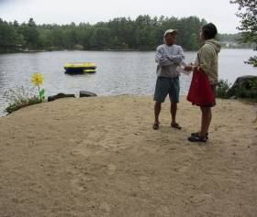
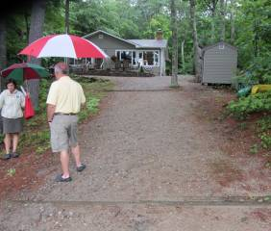
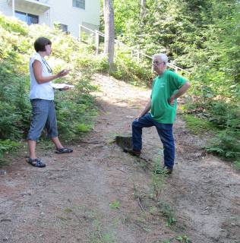
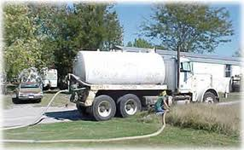
Identify Sources of Pollution
Methods
Volunteer Watershed Survey
Shoreline Survey
Septic System Survey
Stream Crossing Survey
Forestry Activities
Agriculture
Golf Courses
Septic Systems
Notes:
Conduct a watershed survey
Identify hot spots
Prioritize areas for remediation

Slide 16
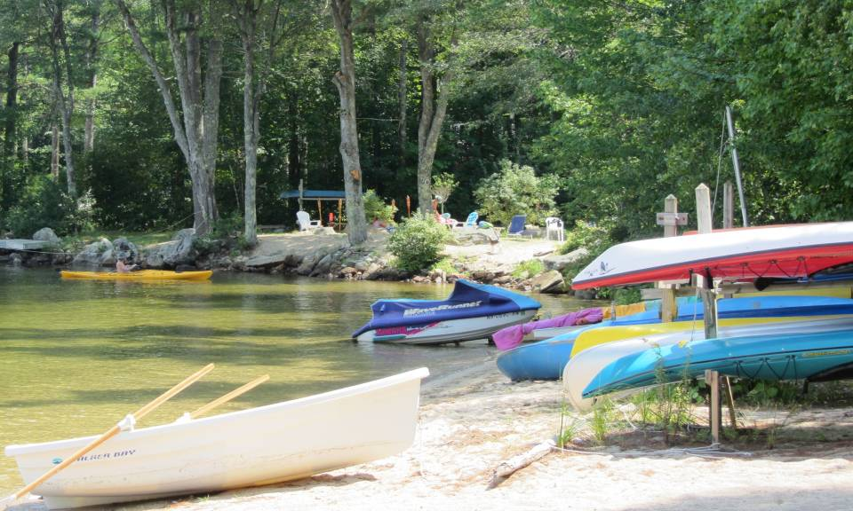
STORMWATER/SEPTIC SURVEY
Conduct a Septic and Stormwater Survey to help address P and DO concerns in lake
Collect baseline information about the state of septic systems in the shorezone (250 ft.)
Estimate P loading from septic systems
Educate watershed citizens about NPS
Notes:
Town of Wolfeboro and LWF received Watershed Assistance Grant for High Quality Waters from NH DES
FBE hired to develop Phase I Watershed Management Plan
Septic and stormwater surveys conducted to address phosphorous and DO concerns in lake

Slide 17
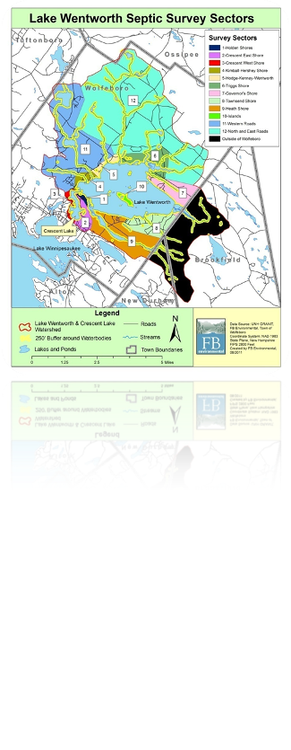
Survey Planning
Identify all properties within 250 ft of waterbodies
Determine sector boundaries
625 Parcels Identified
Contact Volunteers
Notify Landowners
Notes:
Used town zoning, GIS and buildings layer12 Sectors. Total of 625 properties identified

Slide 18
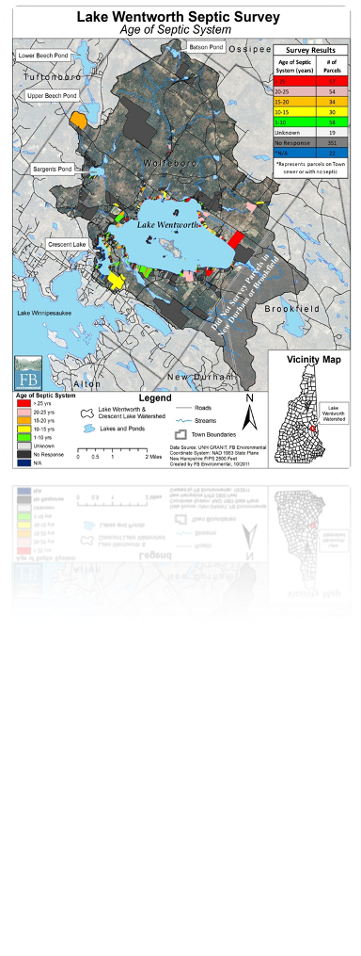
AGE- Septic Survey Results
21% = New (1-10 yrs)
22%= (10-20 yrs)
39%= (>20 yrs)
5%= No Response
Notes:
21% > 25 years. Especially for homes used year-round, not pumped frequently.

Slide 19
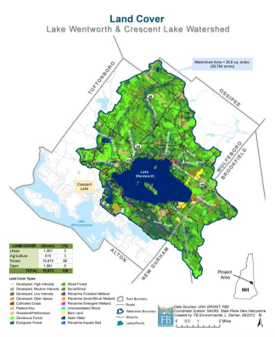
Estimate Loading
Land-Use Modeling
Known coefficients
Estimates pollutant load
Local factors added
Identify land uses with highest loading
Can be used to predict water quality in the future
Notes:
Pounds/acre
Local factors in model- in-lake wq data (from assessment), septic system survey, stream sampling data

Slide 20
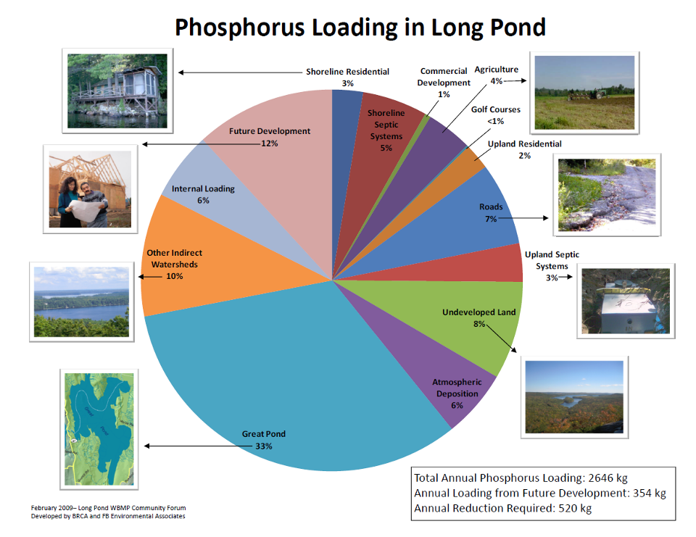

Slide 21

Buildout Analysis
Existing Buildings
Zoning
Growth Rates
Buildout Results
Development Constraints
1) Conservation Land
2) Steep Slopes
3) Wetlands
4) Existing Buildings
5) Hydric Soils
6) Highly Erodible Soils
7) Street ROW (50’)
8) Shoreland Zoning
Assumptions
Notes:
A 4th component:
Development Constraints can be viewed as Environmental Constraints.
21

Slide 22
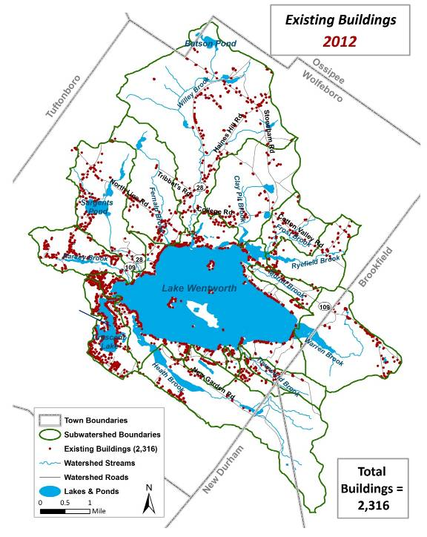
Notes:
The timescope analysis projects growth throughout the watershed based on current growth rates. Granted, if growth rates should increase, then full buildout will occur sooner, and vice versa if growth rates slow.
22

Slide 23
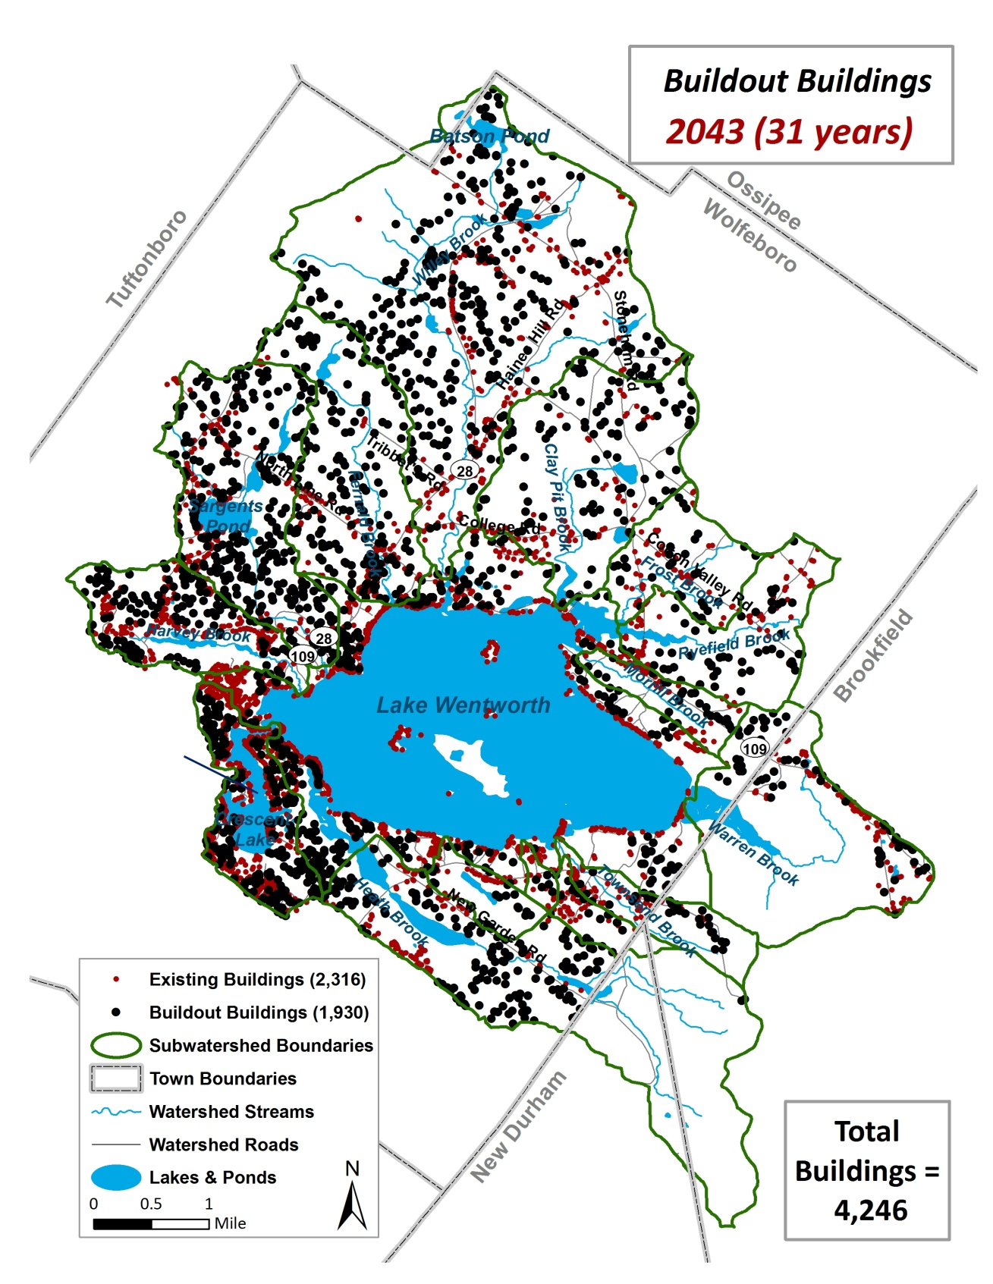
Notes:
The timescope analysis projects growth throughout the watershed based on current growth rates. Granted, if growth rates should increase, then full buildout will occur sooner, and vice versa if growth rates slow.
23

Slide 24
Buildout Results
Additional Phosphorus Loading
Notes:
at a 20-year buildout there would be an 63% increase in Lake Wentworth watershed P runoff loads and a 46% increase in Crescent Lake watershed P runoff loads (note: the increased P load for Crescent Lake includes loading from Lake Wentworth). At full buildout, there would be a 143% increase in Lake Wentworth watershed P runoff loads and an 87% increase in Crescent Lake watershed P runoff loads
Graph: The increased P loading to Lake Wentworth and Crescent Lake is predicted to result in a dramatic increase in in-lake phosphorus concentrations
24

Slide 25
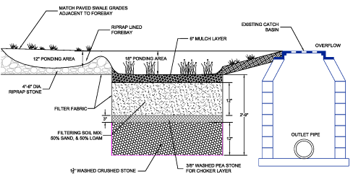
Determine Reductions Needed
# and Types of BMPs needed
Consider Future Development
Notes:
Conduct a watershed survey
Identify hot spots
Prioritize areas for remediation

Slide 26
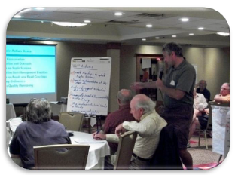
Develop An Action Plan
What are the priorities?
How much will it cost?
Who will pay for the costs?
When will tasks be implemented?
Who will do the work?
How will it be tracked/monitored?
Education & Outreach
BMPs
Municipal Ordinances
Monitoring & Assessment
Notes:
Important: Local Input
WHAT MAKES A SITE HIGH PRIORITY?
High Impact (& Low Cost) “Biggest Bang for the Buck”
Ease of Implementation (willing property owners, town project)
Location, location, location (Highly Visible)
Good YCC or Environmental Education Opportunity
Likelihood of Getting Funded

Slide 27
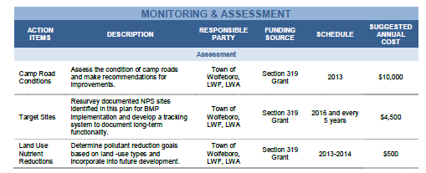
Develop An Action Plan
Education & Outreach
BMPs
Municipal Ordinances
Monitoring & Assessment
Notes:
Important: Local Input
WHAT MAKES A SITE HIGH PRIORITY?
High Impact (& Low Cost) “Biggest Bang for the Buck”
Ease of Implementation (willing property owners, town project)
Location, location, location (Highly Visible)
Good YCC or Environmental Education Opportunity
Likelihood of Getting Funded

Slide 28
Methods to Address Predicted WQ Decline
Improved Zoning
Stormwater Ordinances
Lake Protection Ordinances
Steep Slope Ordinances
Wetland and Shoreland Protection Ordinances
Improved Enforcement of Ordinances
Effective Pollutant Source Tracking and ID
Effective BMP Installation

Slide 29
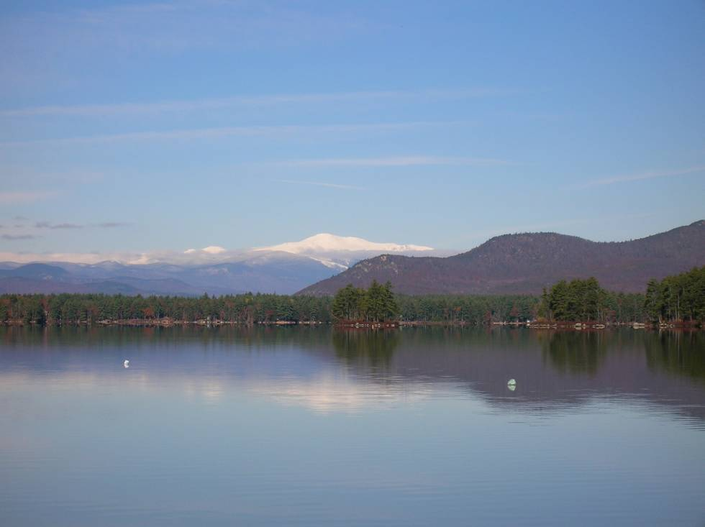
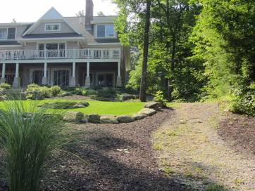
Questions?
      Forrest Bell
      FB Environmental Associates
      1950 Lafayette Rd. ~ Portsmouth, NH
      97A Exchange St. ~ Portland, ME

