Slide 1
Wolfeboro’s
STORMWATER MANAGEMENT REGULATIONS
A Work In Progress

Slide 2
Wolfeboro’s Tool Kit
Implemented tools for water quality protection
Municipal Watershed District
Ground Water Protection Overlay District
Steep Slope Overlay District
Mandatory Conservation Subdivision Ordinance
Change lot coverage requirements
Wetlands Ordinance, including no-touch buffer
Changes to permitted use
A Shoreland Protection Ordinance more restrictive than the State.
Subdivision and Site Plan Review Regulations

Slide 3
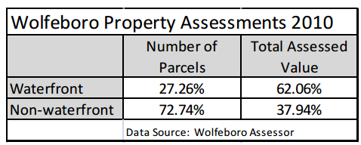
Stormwater Regulations
Why now:
The completion of the Lake Wentworth/Crescent Lake Watershed Management Plan highlighted the impact of storm water runoff on water quality
Water quality is the economic engine that drives our community

Slide 4
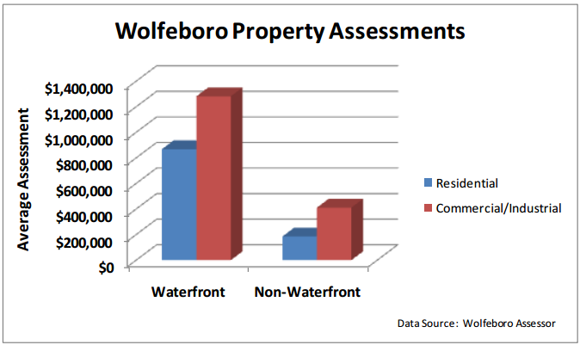

Slide 5
Stormwater Regulations
Current Standards: pre and post peak storm water discharge must be equal or less, no standards for type of stormwater improvements
Proposed Standards Town wide, includes:
  Low Impact Development standards
  Total Suspended Solids (TSS), Phosphorus and Total Nitrogen

Slide 6
Stormwater Regulations
In addition to the recommendations contained in the LW/CL Management Plan
We received input from:
Wolfeboro DPW Director
3 engineering firms
1 Limnologist
Dr. Rob Roseen, UNH Stormwater Center
Maine DEP EPA MS4, Phase II Stormwater Program Manager
We reviewed most NH EPA MS4 Communities regulations

Slide 7
Stormwater Requirements
Stormwater Management Plan:
Developments that disturb 10,000 or more square feet must submit a Stormwater Management Plan
Measures to prevent or minimize water quality and quantity impacts from stormwater both during and after construction.
BMPs, LID source controls, treatment practices and management and maintenance requirements.

Slide 8
Stormwater Requirements
Water Quality Treatment:
Capture of sediment and nutrients suspended in stormwater runoff.
Removal 80% of the total suspended solids (TSS), 50% Total Phosphorus and 50% Total Nitrogen load removal annually.
Where impairments exist, system designs must not cause further impairment of the receiving water.

Slide 9
Stormwater Regulations
Drainage Analysis and Operation and Maintenance Plan includes:
Calculations comparing Pre and Post-Development stormwater runoff rates on a 1-inch rainstorm, and the 2-­year, 10-year, 25-year and 100-year 24-hour frequency storms
Drainage Analysis Summary
Copies of any additional permits
Operation and Maintenance Plan maintenance of all proposed stormwater management improvements

Slide 10
Stormwater Regulations
New Development requires:
Low Impact Development used to the maximum extent possible.
All stormwater treatment areas shall be planted to prevent soil erosion and to promote proper treatment of the proposed runoff.
Runoff from snow and salt storage areas shall enter treatment areas.
Runoff shall be directed into recessed vegetated and landscape areas designed for treatment and/or filtration to the maximum extent possible.
Retain stormwater on the site by using the natural flow patterns of the site.

Slide 11
Stormwater Regulations
Redevelopment Project Requirements:
Redevelopment sites with more than 40% existing impervious surface coverage:
Implementation of measures onsite that result in an Effective Impervious Area of at least 30% of the existing impervious surfaces and pavement areas, and 50% of the additional proposed impervious surfaces and pavement areas through the application of porous media; or
Implementation of other Low Impact Development techniques onsite to the Maximum Extent Practicable to provide treatment for at least 50% of the redevelopment area; or
Implementation of off­site BMPs to provide adequate water quality treatment for an area equal to or greater than 50% of redevelopment areas.

Slide 12
Post Development Monitoring
Record Keeping
Owner is required keep records of the installation, maintenance and repairs to the system, and shall retain records for at least five years and shall:
Provide a copy of the post construction inspection checklist based on the inspection cycle prescribed by the Operation and Maintenance Plan.
Provide records of all maintenance and repairs to the Director of Planning and Development, during inspections and/or upon request.

Slide 13
Post Development Monitoring
Inspection Forms Include:
Scheduled Inspection Form
Storm Drain Outfall Characteristics Form
Catch Basin Inspection Form
  Basin Location, Flow, Condition, Sheen, Sediment

Slide 14
Streamlining the Process
Checklist and Forms
  Application Submittal Checklist
  Phosphorus load calculation forms (Maine DEP)
  Post construction maintenance and inspection forms

Slide 18
Resources
http://www.maine.gov/dep/land/stormwater/
http://www.unh.edu/unhsc/
http://des.nh.gov/organization/divisions/water/stormwater/
http://www.thinkbluemaine.org/toolbox/index.htm

Slide 19


Slide 20


Slide 21
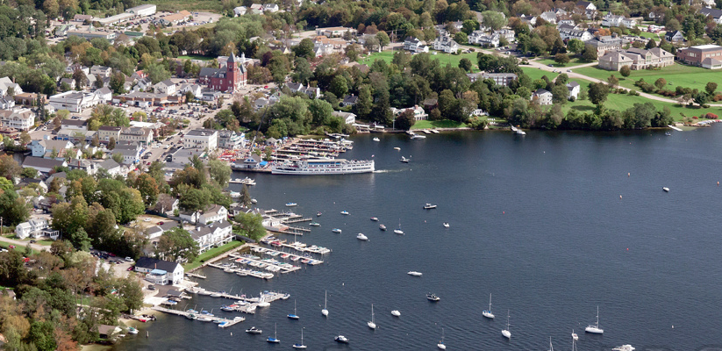
Photo by Bob Ness

